Slide 1


PAAVAI ENGINEERING COLLEGE (AUTONOMOUS) DEPARTMENT OF INFORMATION TECHNOLOGY MALWARE FAMILIES IDENTIFICATION USING DENSENET MODEL FROM BINARY IMAGES
SECOND ^{ND} REVIEW BATCH NO: 15
GUIDED by: PRESENTED by:
Mr.S.RAJESH M.E, PANDI .C (20202035) Assistant Professor, M.SABARESH(20202044) Department of IT, S.M.N NITHEESHWARAN (20202033)
Paavai Engineering College.

Slide 2
ABSTRACT
To detect and classify malware, an anti-virus program is based on two commonly used techniques which are signature-based and behavior-based detection.
The signatures of the malware are usually obtained from known malware by doing static analysis (without execution of the malware).
Nowadays, there are countless types of malware attempting to damage companies’ information systems.
Thus, it is essential to detect and prevent them to avoid any risk. Malware classification is a widely used task that, as probably know, can be accomplished by machine learning models quite efficiently.
Project focus on an interesting malware types classification method based on transfer learning named as DenseNet Model

Slide 3
OBJECTIVE
The main objective is to classify the malware images using deep learning algorithm
It includes the DenseNet model to improve the accuracy in multiple malware classification

Slide 4
INTRODUCTION
Malware, short for malicious software, poses a significant threat to computer systems, networks, and digital assets worldwide.
As cyber threats continue to evolve in sophistication and diversity, detecting and analyzing malware becomes increasingly challenging. Traditional signature-based detection methods often struggle to keep pace with the rapid proliferation of new malware variants.
In response, cybersecurity professionals turn to advanced techniques, including machine learning and deep learning, to enhance their capabilities in identifying and mitigating malware threats.

Slide 5
Problem statement
Malicious programs intended to cause harm and damages are referred to as malware. As they have multiple types, among which some being more harmful, some less and some not harmful at all.
The need of malware classification can be easily understood from the fact that malwares have such broad categories and are difficult to simply identify their classes from one another.
Different scholars have proposed different new techniques, some have done using the pre-existing methods for classification. Mainly shallow machine learning techniques have been used for classifying malware samples.
So develop the framework to classify the multiple malware images using DenseNet framework

Slide 6
EXISTNG SYSTEM
k-Nearest neighbor algorithm : Search the malwares in datasets
Support vector machine algorithm: Classify the binary images
Manual testing: Check the binary files in system with manual automation
Convolutional neural network: Malware types classification and model build for trained images

Slide 7
Proposed system
Malicious programs intended to cause harm and damages are referred to as malware. As they have multiple types, among which some being more harmful, some less and some not harmful at all.
The need of malware classification can be easily understood from the fact that malwares have such broad categories and are difficult to simply identify their classes from one another.
So in this project implement the algorithm named as transfer learning which includes DenseNet framework to classify the uploaded Malware images
Provide the type of malwares data with improved accuracy rate

Slide 8
advantages
Improved accuracy rate
Multiple malwares are analyzed
Time and computational complexity can be reduced

Slide 9
System requirements
HARDWARE REQUIREMENTS
Processor : Intel processor 2.6.0 GHZ
RAM : 2 GB
Hard disk : 160 GB

Slide 10
System requirements
SOFTWARE REQUIREMENTS
Server Side : Python
Client Side : HTML, CSS, Bootstrap
IDE : Flask 1.1.1
Back end : MySQL 5.
Server : WampServer 2i
OS : Windows 10 64 –bit

Slide 11
modules
DATASETS COLLECTION
MODEL BUILD
PERFORMANCE EVALUATION
INPUT BINARY IMAGE
MALWARE CLASSIFICATION

Slide 12
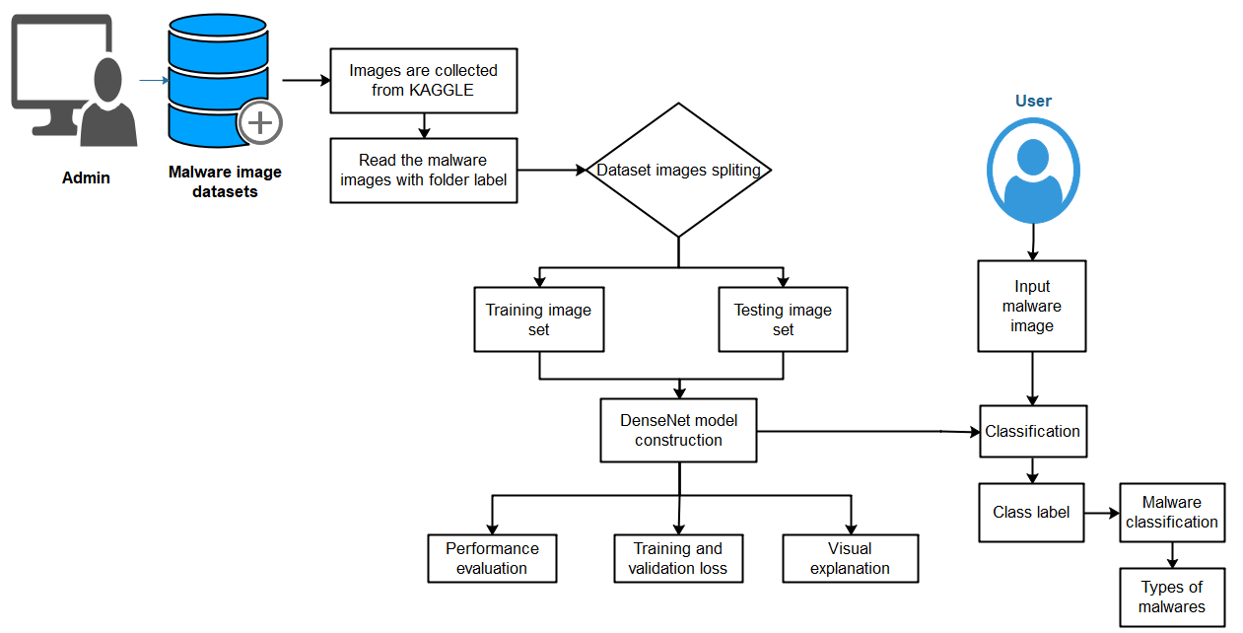
System architecture

Slide 13
REFERENCES
Belal, Mohamad Mulham, and Divya Meena Sundaram. "Global-Local Attention-Based Butterfly Vision Transformer for Visualization-Based Malware Classification." IEEE Access (2023).
Peppes, Nikolaos, et al. "Malware Image Generation and Detection Method using DCGANs and Transfer Learning." IEEE Access (2023).
Kim, Jeongwoo, Joon-Young Paik, and Eun-Sun Cho. "Attention-Based Cross-Modal CNN Using Non-Disassembled Files for Malware Classification." IEEE Access 11 (2023): 22889-22903.
Khan, Faiza Babar, et al. "Detection of Data Scarce Malware Using One-Shot Learning With Relation Network." IEEE Access (2023).
Geremias, Jhonatan, et al. "Towards a Reliable Hierarchical Android Malware Detection Through Image-based CNN." 2023 IEEE 20th Consumer Communications & Networking Conference (CCNC). IEEE, 2023.

Slide 14
THANK YOU

